Slide 1
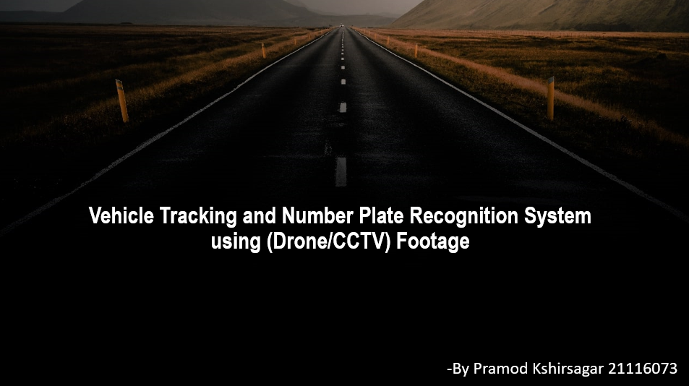

Slide 2

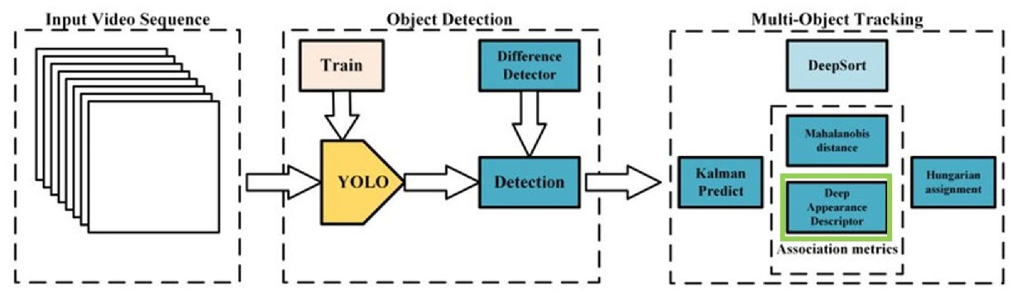

General Idea of the Process followed
The main task of tracking vehicles in a video involved a combination of computer vision and machine learning techniques to detect, track, classify, and recognize vehicles in a video.
Object Detection: The YOLO algorithm was used detect vehicles and draw bounding boxes around them.
Object Tracking: I finalized 2 Approaches for Tracking, both having Kalman filter algorithm which can predict their location in the next frame. (DeepSORT and ByteTrack)

Slide 3
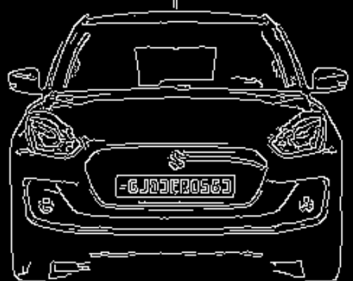
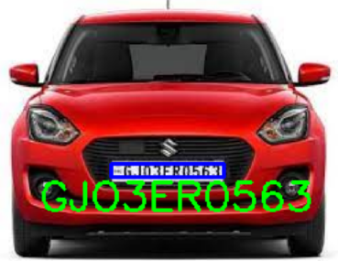
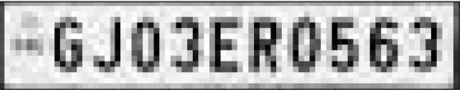
General Idea of the Process followed
Vehicle Classification: After the vehicles have been tracked, the next step was to classify them into different classes, such as car, bus, truck, motorcycle, etc. This can be done using a classification model, such as a CNN based yolo, that has been trained on a large dataset of vehicle images.
Number Plate Recognition: This involved preprocessing the image to enhance the contrast and remove noise, segmenting the characters from the background, and then recognizing the characters using an Optical Character Recognition algorithm EasyOCR.

Slide 4



VARIOUS APPROACHES
ByteTrack
DeepSORT
Just Yolov4

Slide 5

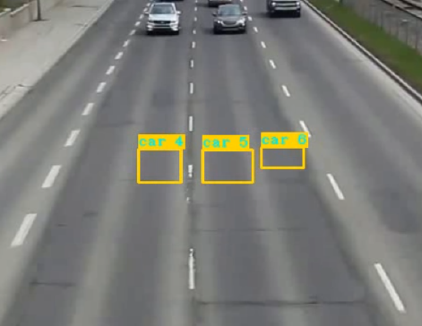
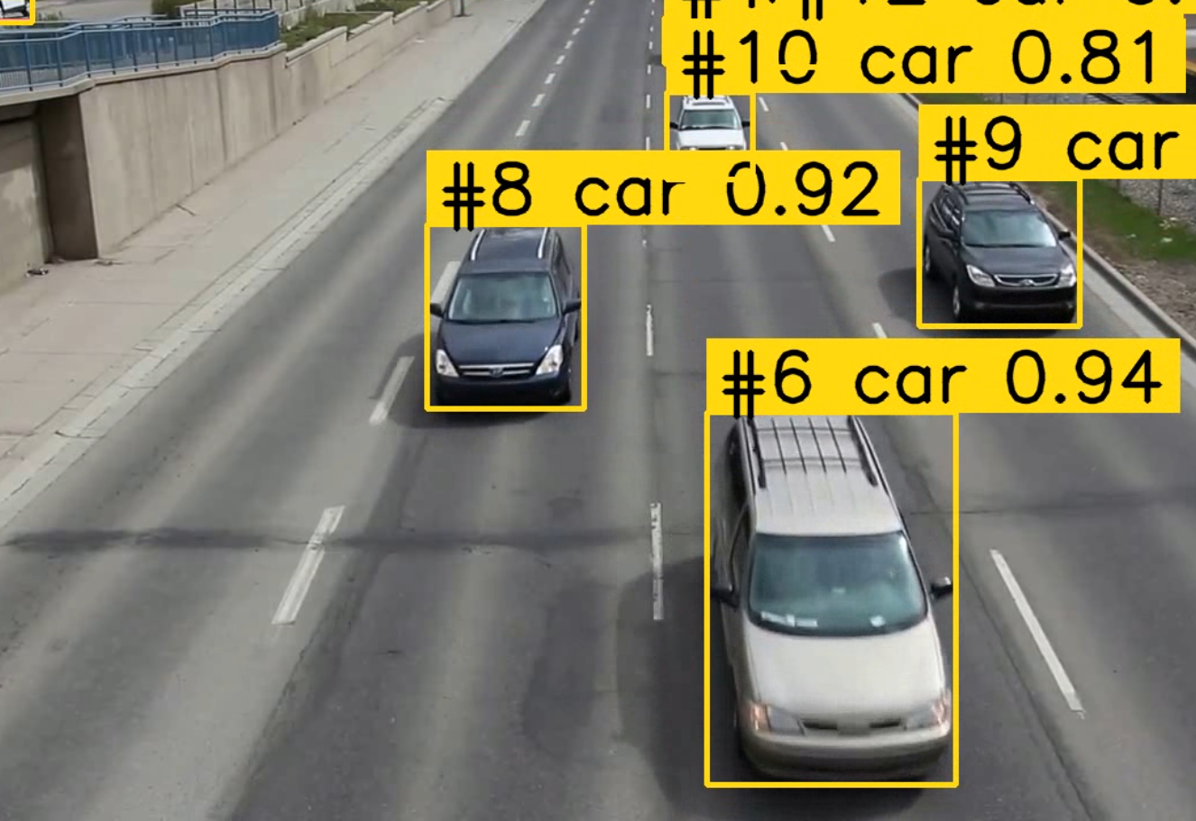
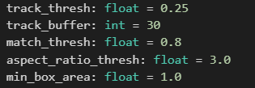
CHALLENGES
Before
Getting the best parameters for good detections and smooth Tracking
For Ex: class_threshold, Model Width, etc.
Final

Slide 6
CHALLENGES
Making the output process smooth and fast.
I reduced the number of classes and tried a better yolo version of CNN.
Custom training yolo using annotations, led to less data and inaccurate detections.
Had to go with the pretrained weights.

Slide 7

KEY LEARNINGS
The working and depths of Object Tracking.
How Predictions work in Tracking Algorithms
Key Parameters that affect detections.
Image processing using OpenCV

Slide 8



Thank You

